Slide 1


Heart Failure Prediction
Using Supervised ML
Gnanendar 200070053
Jaideep 200070035
Jay 20D170017

Slide 2
INDEX
Introduction
Role of ML in healthcare
Methodology
Modeling
Conclusion

Slide 3
Introduction
Motivation: Heart failure is one of the biggest reason for death across the globe, as it is cause of 35% of total death worldwide. If we are able to predict heart disease on the basis on certain parameters it would be helpful
Heart failure is a serious and common condition. The annual incidence of heart failure in India is estimated to be 0.5 – 1.8 million people
Machine learning can be used to develop non-invasive and low-cost methods of heart failure prediction. This could make it possible to diagnose heart failure earlier and more widely acceptable

Slide 4
Introduction
Attributes taken into account
Age: Age of patient [years]
Sex: Sex of the patient [M: Make, F: Female]
Chest Pain Type: There are 4 different types of chest pain addressed in this dataset; TA: Typical Angina, ATA: Atypical Angina; NAP: Non-Anginal Pain; ASY: Asymptomatic.
Resting Blood Pressure:
Cholesterol: serum cholesterol [mm/dl]
Fasting BS: [1: if FastingBS > 120 mg/dl, 0: otherwise]
Resting ECG: [Normal: Normal, ST: having ST-T wave abnormality, LVH: showing probable left ventricular hypertrophy]
Max HR: [Numeric value between 60 and 202]
Exercise Angina: [Y: Yes, N: No]
Old Peak: [Numeric value measured in depression]
ST Slope: [Up: upsloping, Flat: flat, Down: downsloping]

Slide 5
2. Role of ML in healthcare
Early detection and Risk prediction : Analyze diverse patient data, including vital signs, medical history, and diagnostic tests
Diagnostic Support : Analyzing symptoms, imaging data (like echocardiograms), and biomarkers
Personalized Treatment Approaches : development of personalized treatment strategies by analyzing patient-specific data, such as genetic markers and response to previous treatments
Remote Monitoring and Telemedicine : remote monitoring systems continuously track physiological parameters, providing real-time insights into a patient's condition
Research and Drug Development : Expediting research efforts by analyzing vast datasets and aiding in the discovery of new biomarkers, potential therapies, and drug responses related to heart failure

Slide 6
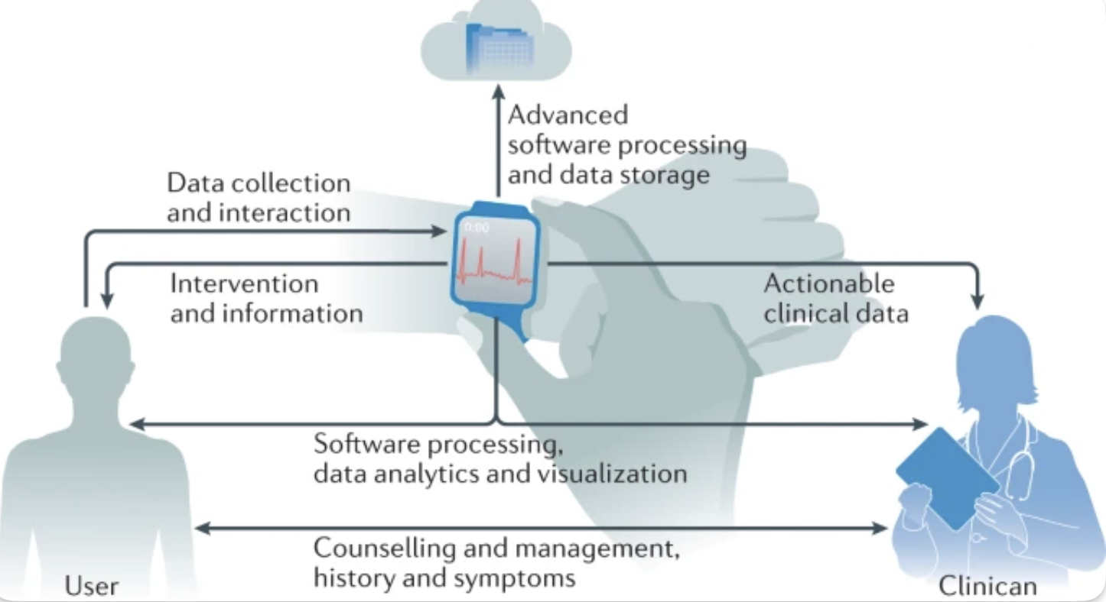
2. Role of ML in healthcare
Integration of wearable technology
Smart Watch can detect:
Resting Blood Pressure
Resting ECG
Heart Rate
Old Peak
ST Slope
Clinician Assistance is required for:
Chest Pain Type
Cholesterol
Fasting BS
Nature Medicine. (2021). Beyond the numbers: Understanding the complex interactions that contribute to heart failure with preserved ejection fraction. Nature Reviews Cardiology, 18(11), 719-720. https://www.nature.com/articles/s41569-021-00522-7

Slide 7
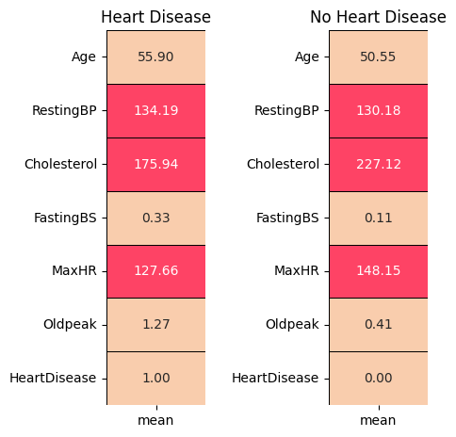
3. Methodology
Acquiring the dataset and categorizing it in the type of data
Creating the mean distribution of the data and sorting it in “Heart Disease” and “No Heart Disease”
S No. | Column | Data Type
1 | Age | int64
2 | Sex | object
3 | ChestPainType | object
4 | RestingBP | int64
5 | Cholesterol | int64
6 | FastingBS | int64
7 | RestingECG | object
8 | MaxHR | int64
9 | ExerciseAngina | object
10 | Oldpeak | float64
11 | ST_Slope | object
12 | HeartDisease | int64
Figure 1: Mean Distribution of dataset for a) Heart Disease, b) No Heart Disease

Slide 8
3. Methodology
3. Dividing the features in Categorical and Numerical feature
4. Analysing distribution of categorical features (Figure 2) and numerical features (Figure 3)
5. Analyze categorical features vs Target variable (Figure 4)
Categorical feature: Sex, Chest Pain Type, Fasting BS, Resting ECG, Exercise Angina, ST Slope
Numerical feature: Age, Resting BP, Cholesterol, Max HR, Oldpeak

Slide 9
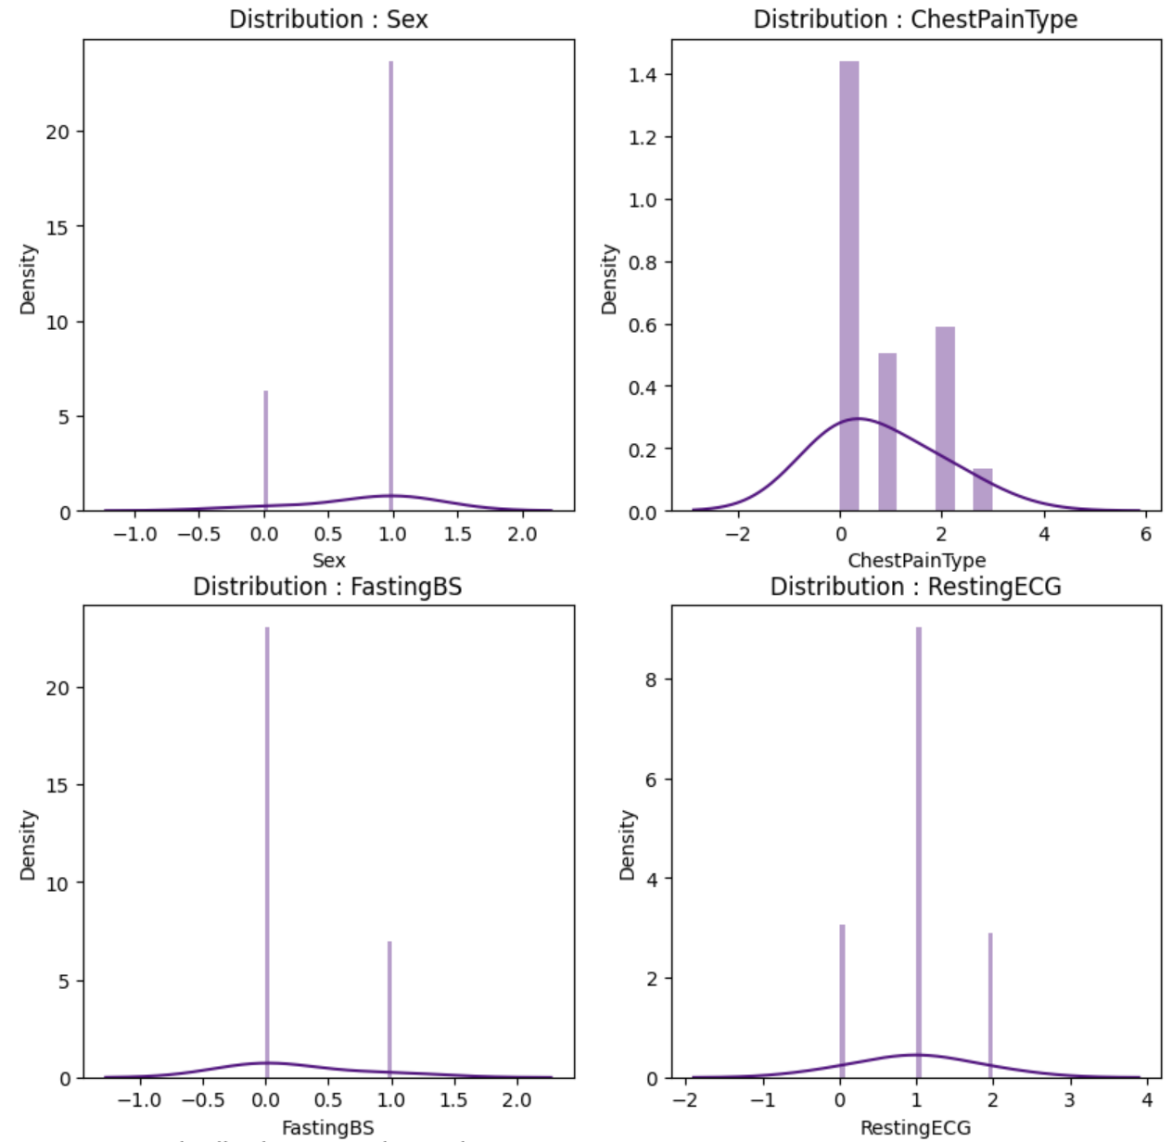
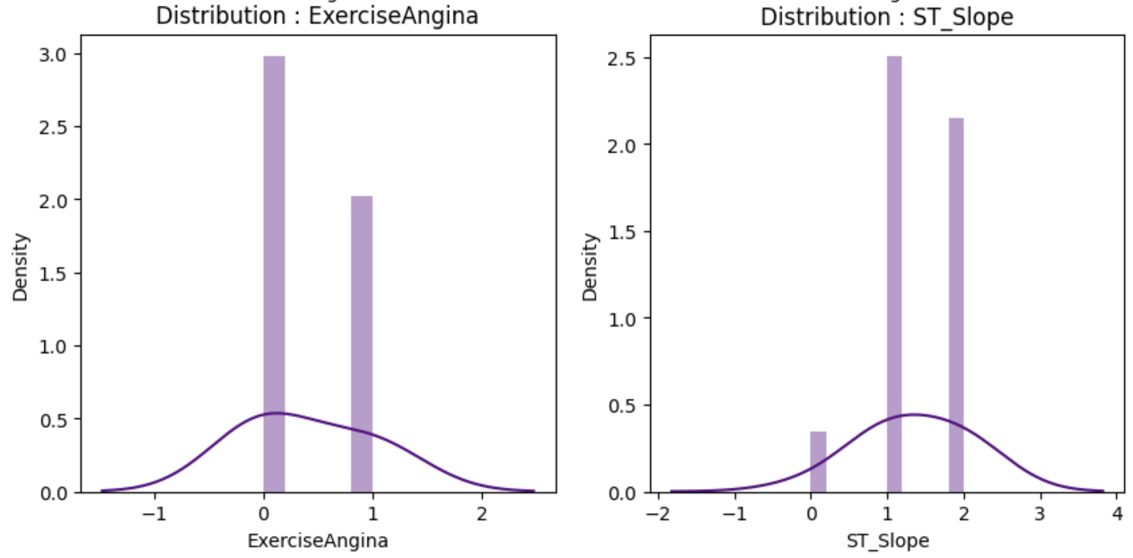
3. Methodology
Categorical Features: Sex, Chest Pain Type, Fasting BS, Resting ECG, Exercise Angina, ST Slope
Figure 2: Distribution of Categorical Features

Slide 10
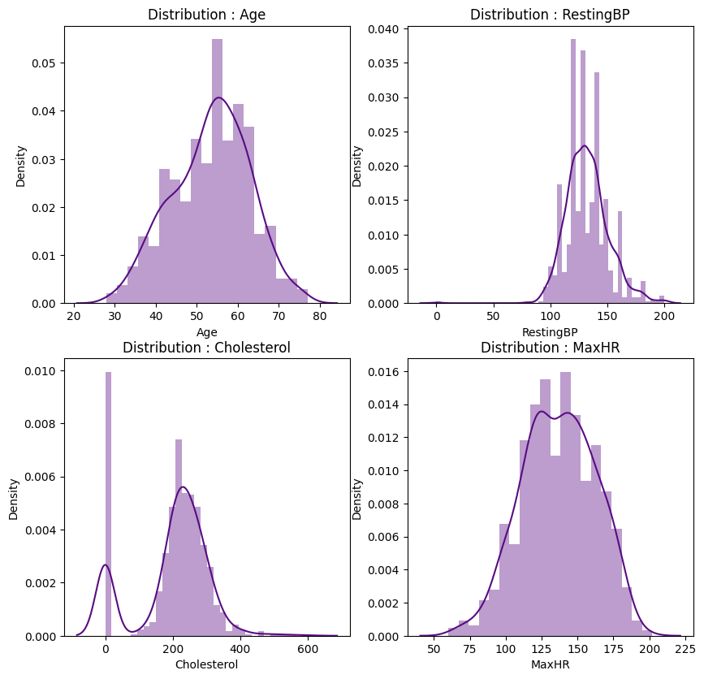
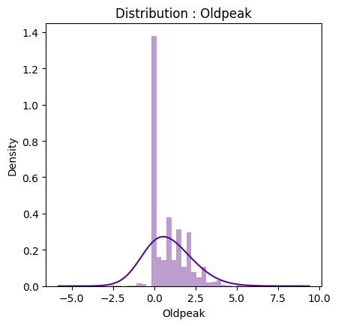
3. Methodology
Numerical Feature: Age, Resting BP, Cholesterol, Max HR, Oldpeak
Figure 3: Distribution of Numerical Features

Slide 11
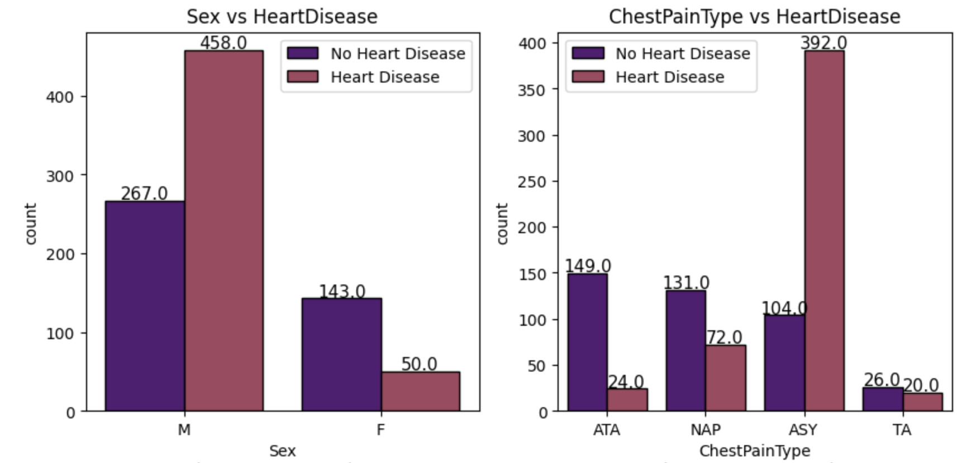
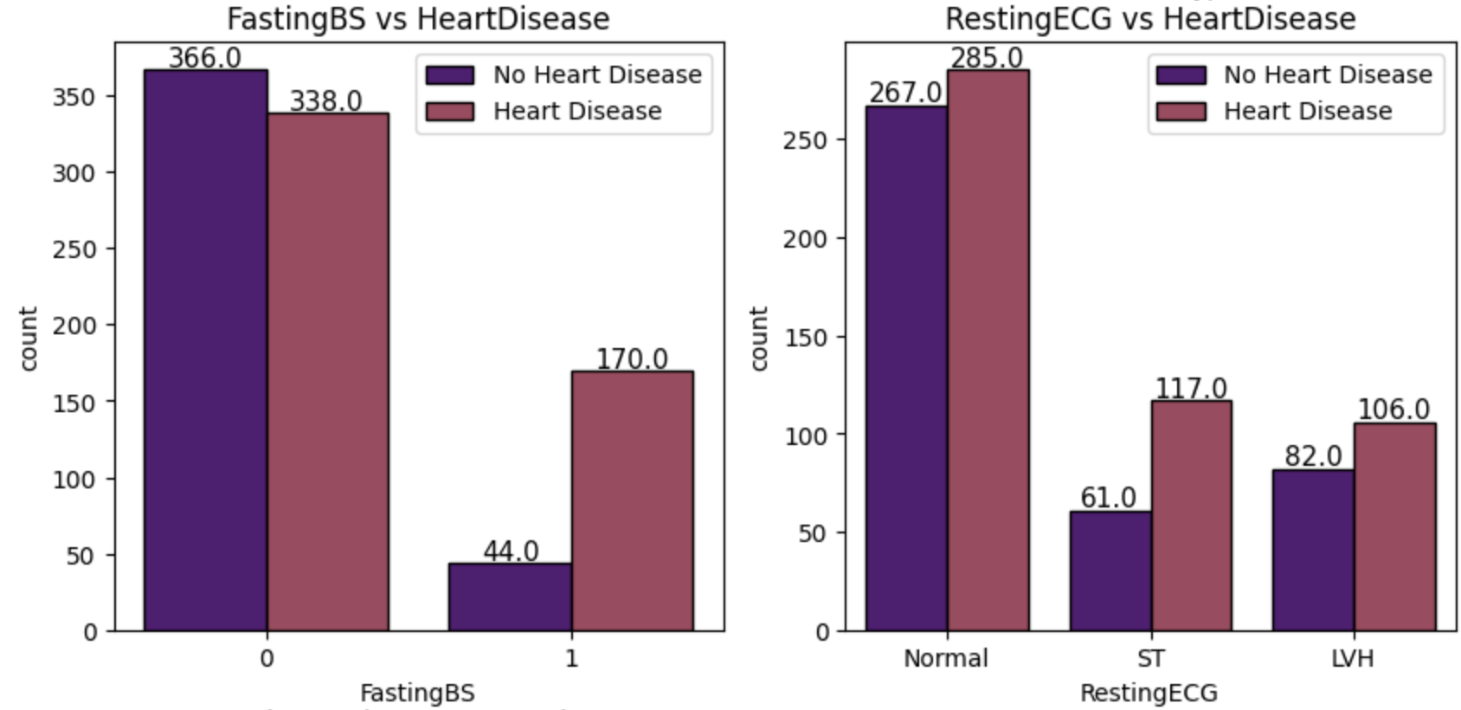
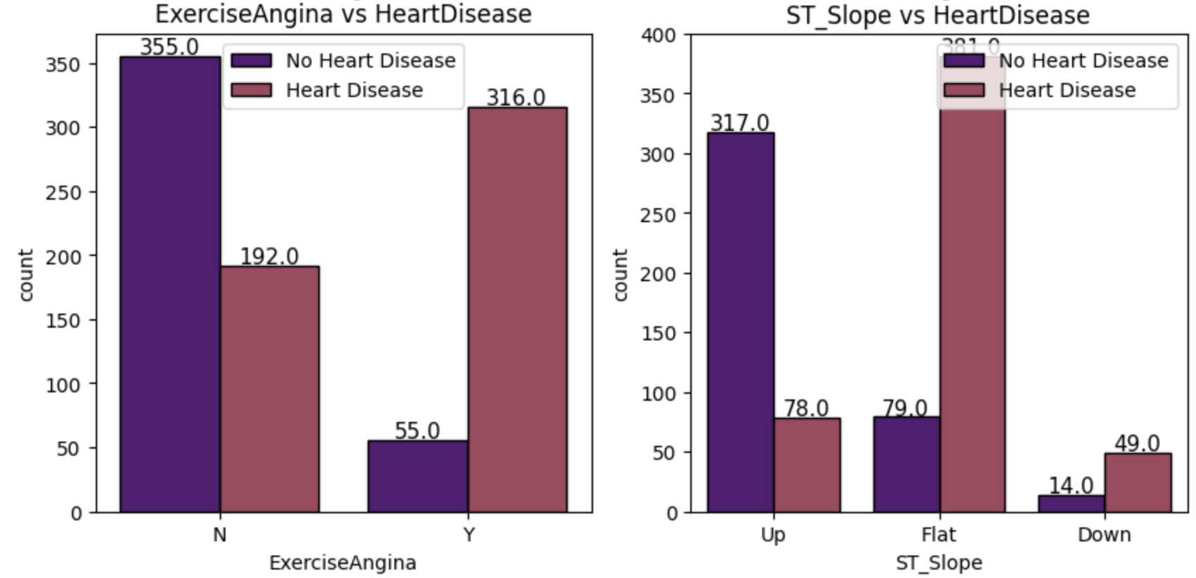
3. Methodology
Categorical Feature
63% of male and 26% of females are affected by heart disease.
ASY chest pain or Fasting BS is 0, there is 80% chances of heart disease
Exercise Angina as Y shows 85% risk of heart disease
Figure 4(a): Distribution of Categorical Features
Notes:
After distributing the data in categorical and numerical parameters, we analyzed the data starting with categorical parameters

Slide 12
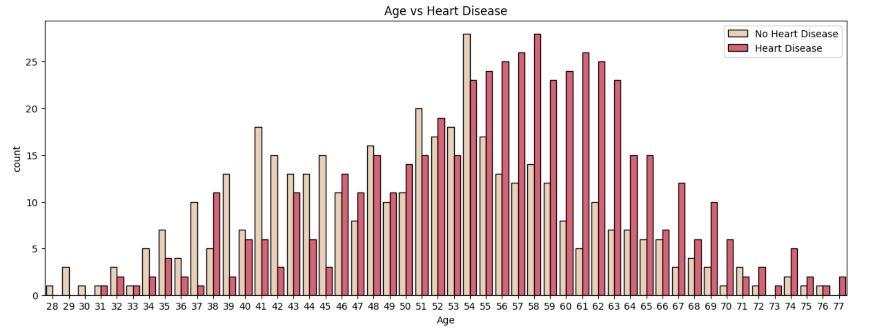
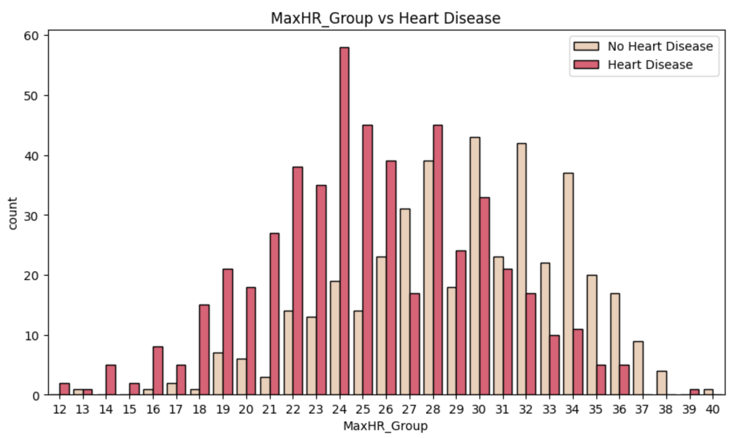
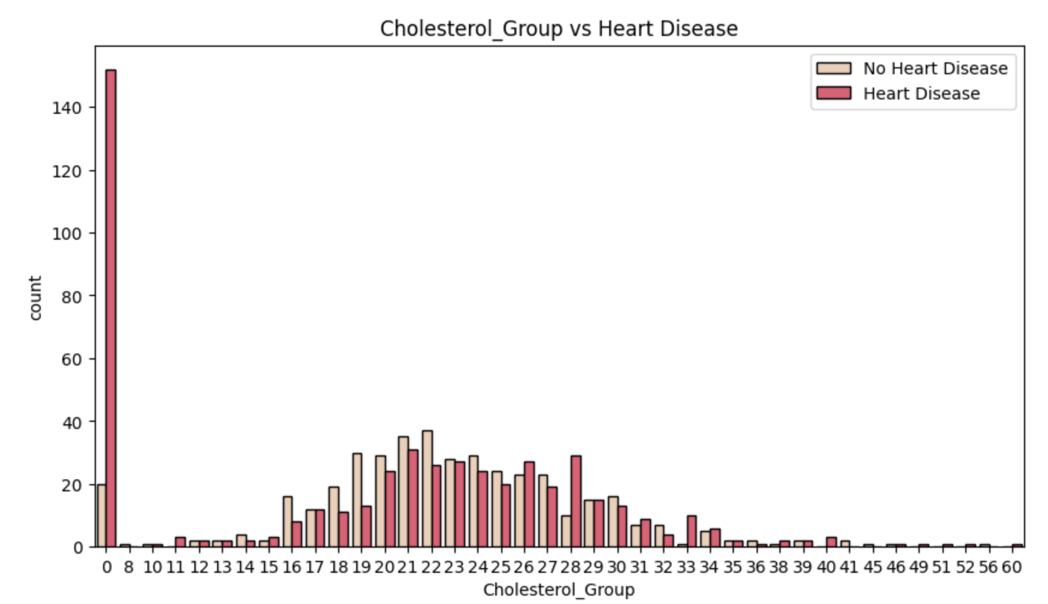
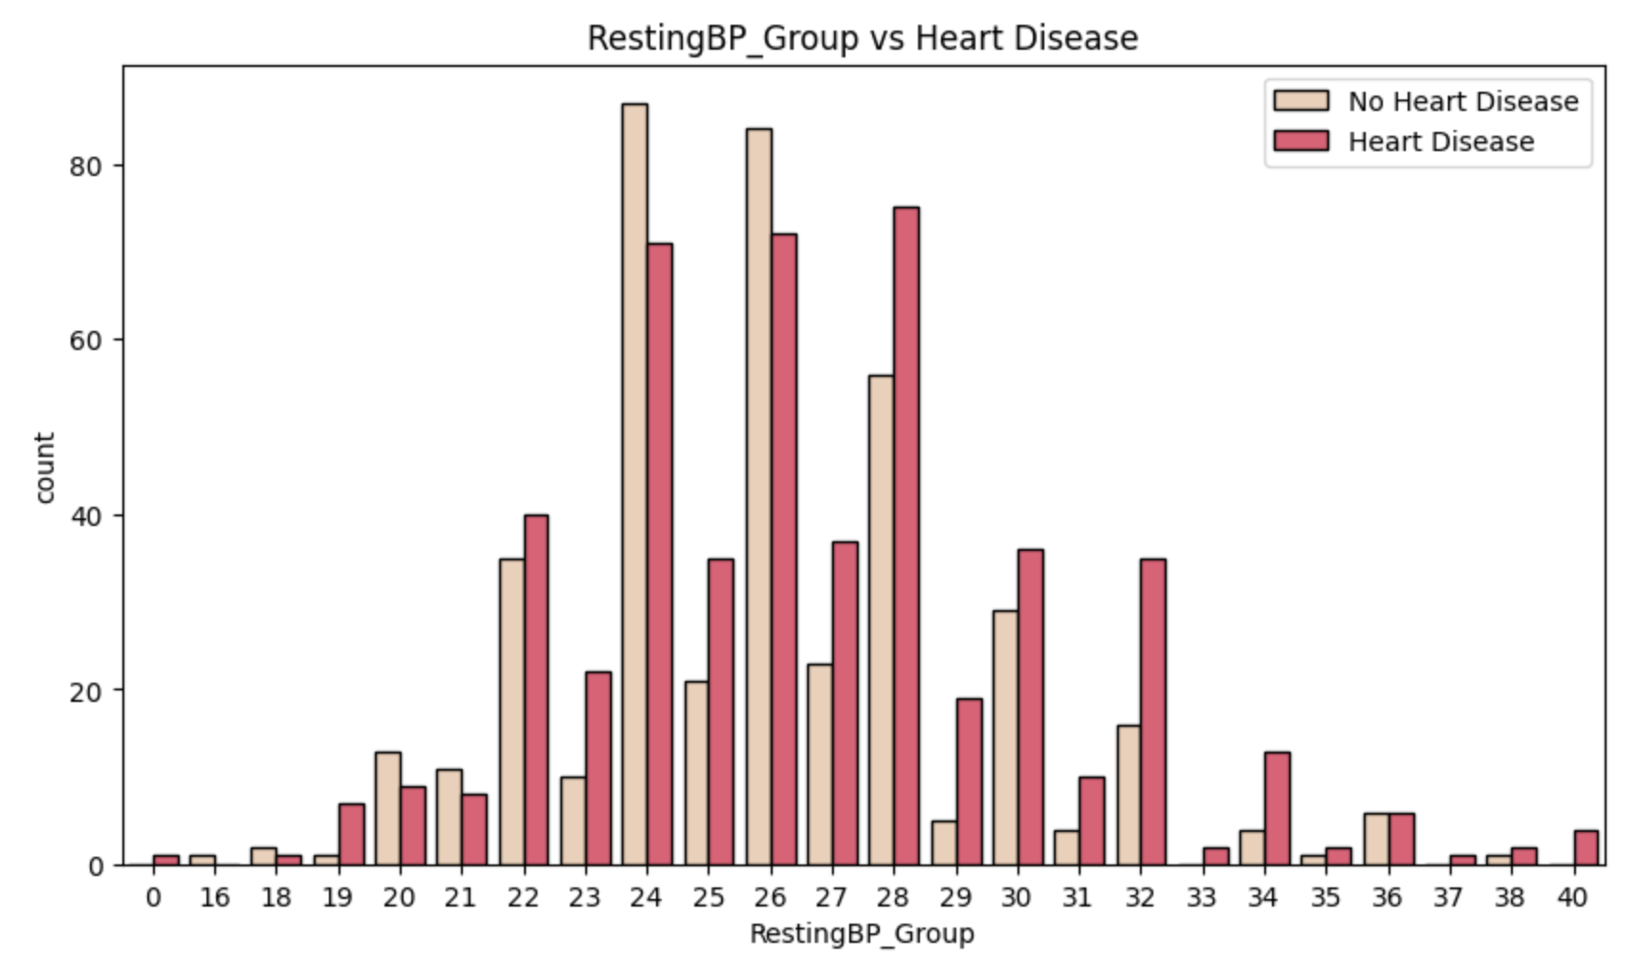
3. Methodology
Numerical Features
As age increases risk of heart disease also increases
Higher value of Max HR shows sign of healthy heart
With increase in Old peak risk of heart disease also increases
Cholesterol having value near 200 is good for heart
Figure 4(b): Distribution of Numerical Features
Notes:
After distributing the data in categorical and numerical parameters, we analyzed the data starting with categorical parameters

Slide 13
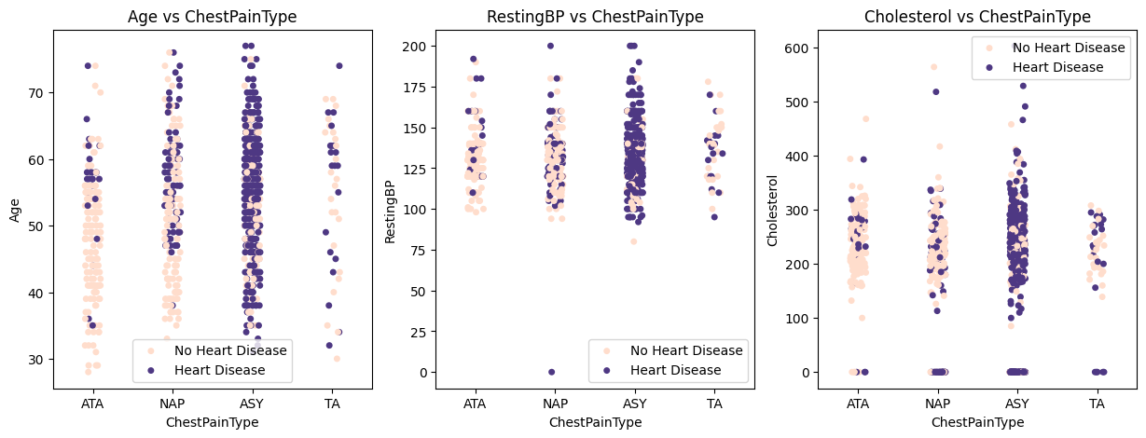
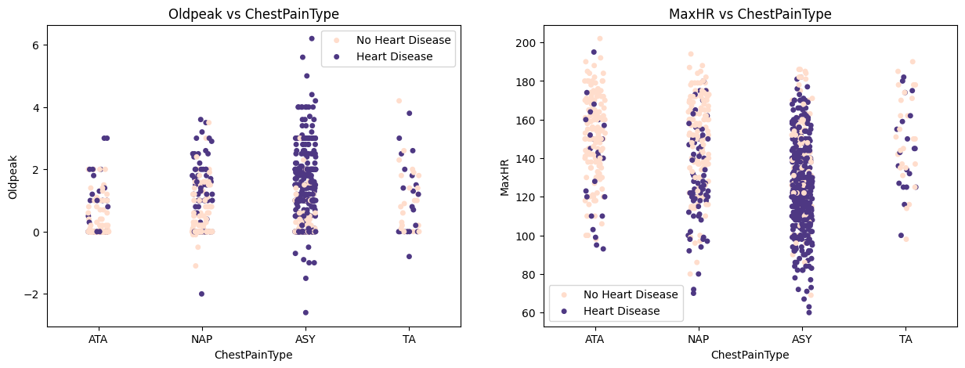
3. Methodology
6. Analysing the data based on Categorical feature vs Numerical feature: (Fig 5) 6.1 Sex
6.2 Chest Pain Type
6.3 Fasting BS
6.4 Resting EEG
6.5 Exercise Angina
6.6 ST Slope
7. Analysing the data based on Numerical feature Vs Numerical Feature (Fig 6)
Figure 5: Example of Chest Pain type Vs Numerical Features

Slide 14
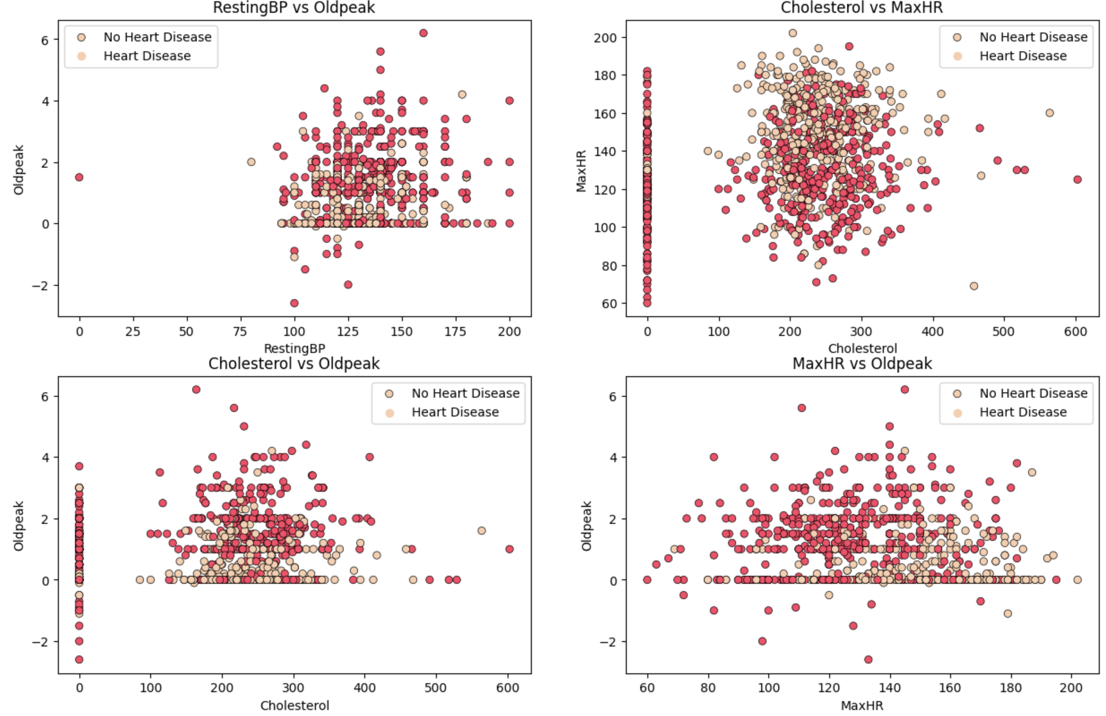
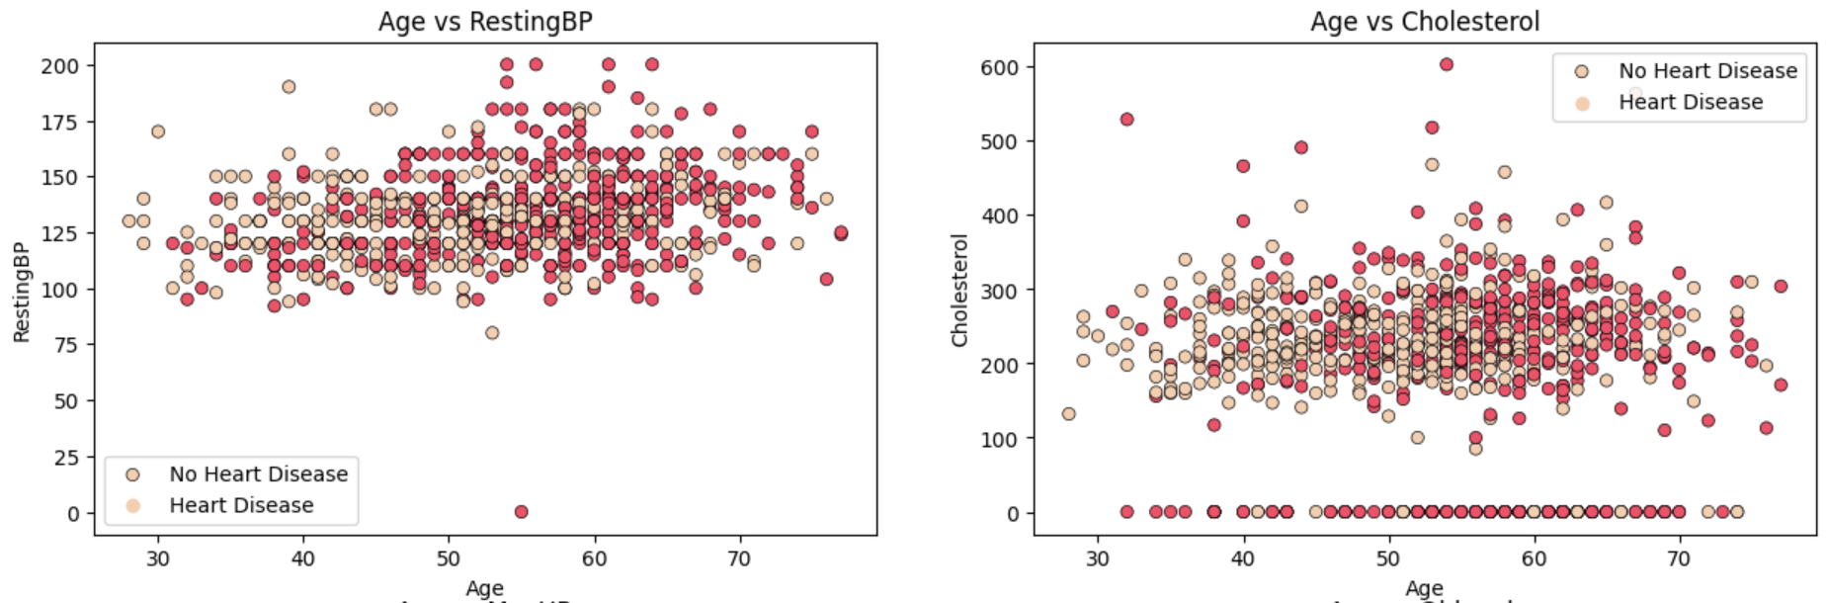
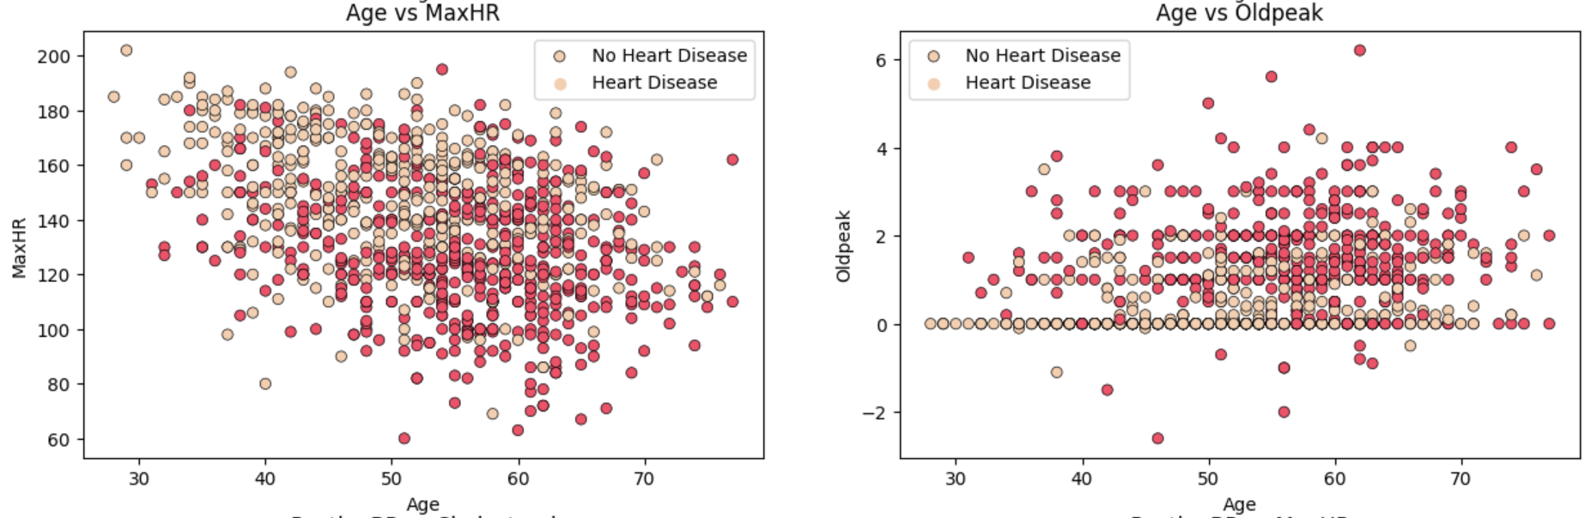
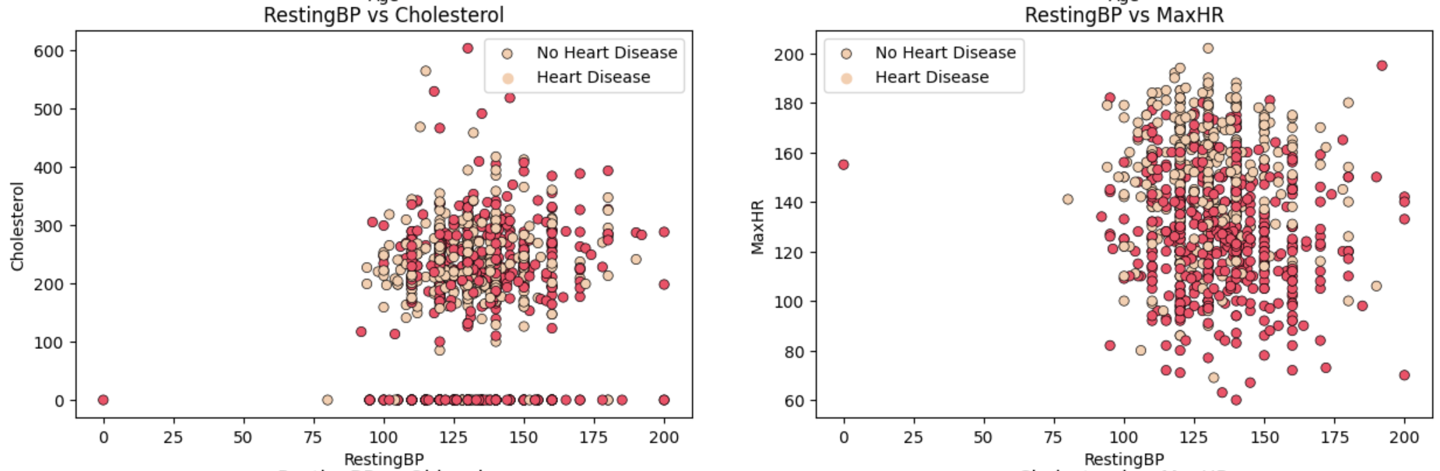
3. Methodology
Numerical vs Numerical Feature
Figure 6: Distribution of Numerical features to Numerical features

Slide 15
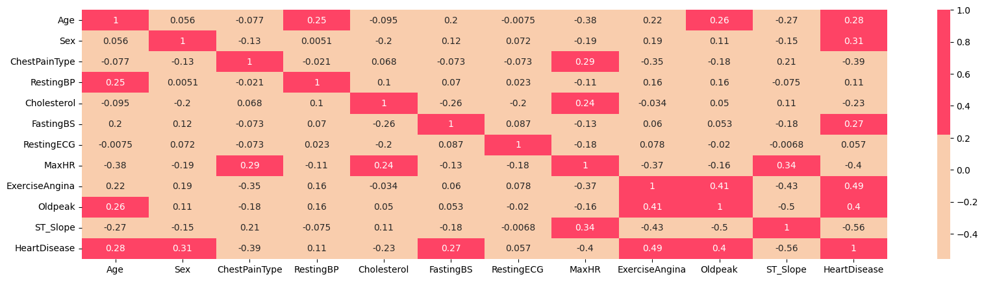
3. Methodology
8. Creating a correlation matrix to identify the main features (Fig 7)
Figure 7: Correlation Matrix
9. Using Chi-Squared Test for feature selection of Categorical Feature Selection, and ANOVA test for Numerical Feature selection (Fig 8)

Slide 16
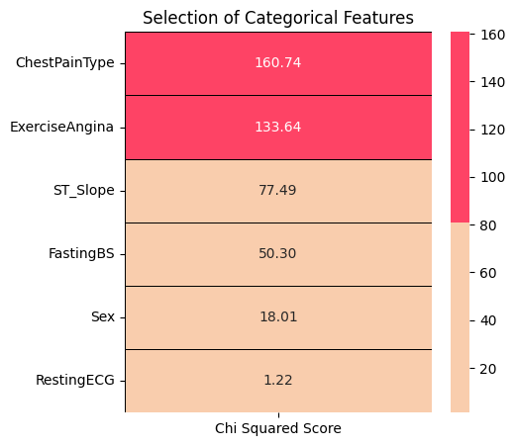
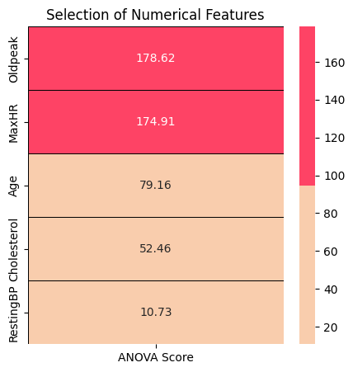
3. Methodology
Figure 8: Illustration of Chi square test for selecting Categorical feature and ANOVA test for selecting Numerical feature

Slide 17
4. Modelling
1. Logistic Regression: Estimates the probability that an instance belongs to a particular class based on input features, using a logistic function.
2. Support Vector Classifier (SVC): It constructs a hyperplane or set of hyperplanes in a high-dimensional space, aiming to maximize the margin between classes, thus classifying data points.
3. Decision Tree Classifier: A tree-like model that recursively partitions the input space into regions, making decisions based on feature values to classify instances
4. Random Forest Classifier: A method that builds multiple decision trees and combines their predictions through voting or averaging, resulting in improved accuracy and reduced overfitting compared to individual trees.
5. K-Nearest Neighbors (K-NN) Classifier: A non-parametric algorithm that classifies instances based on the majority class of its K nearest neighbors in the feature space, where K is a predefined number.

Slide 18
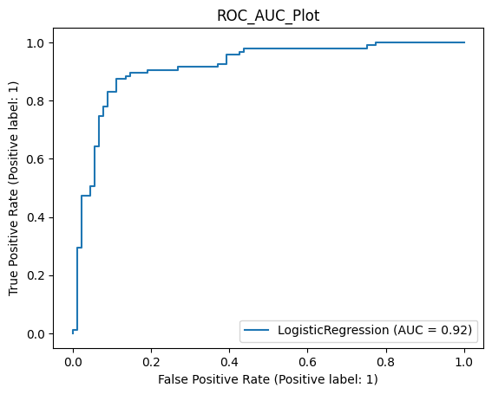
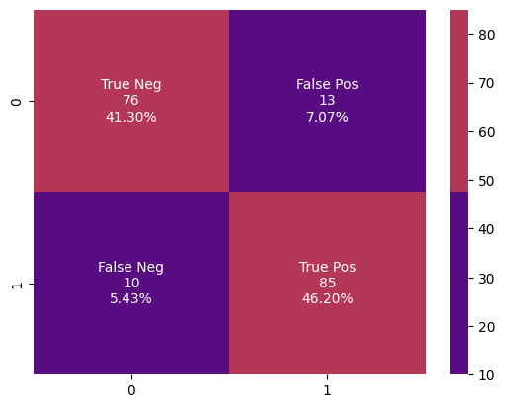
4. Modelling
1. Logistic Regression:
Accuracy : 87.50% Cross Validation Score : 91.12% ROC_AUC Score : 87.43%

Slide 19
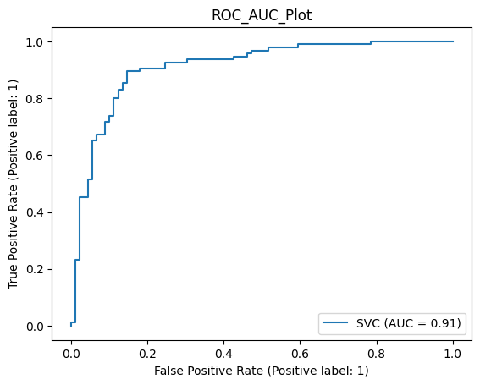
4. Modelling
2. Support Vector Classifier
Accuracy : 87.50% Cross Validation Score : 90.53% ROC_AUC Score : 87.43%

Slide 20
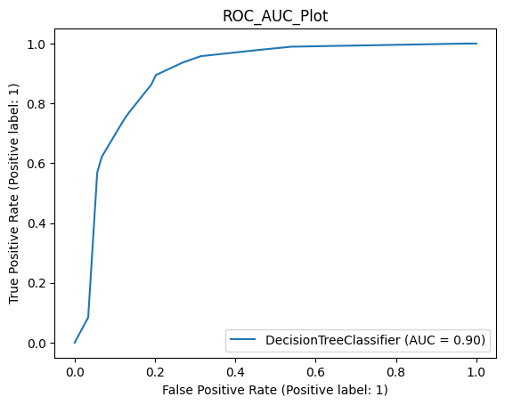

4. Modelling
3. Decision Tree Classifier
Accuracy : 84.78%
Cross Validation Score : 89.09%
ROC_AUC Score : 84.62%

Slide 21
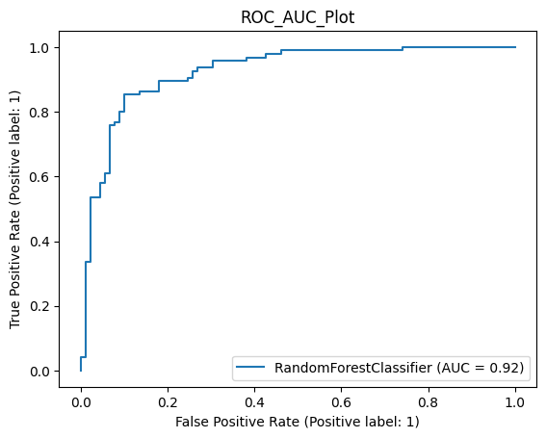

4. Modelling
4. Random Forest Classifier
Accuracy : 84.24%
Cross Validation Score : 92.91%
ROC_AUC Score : 84.06%

Slide 22
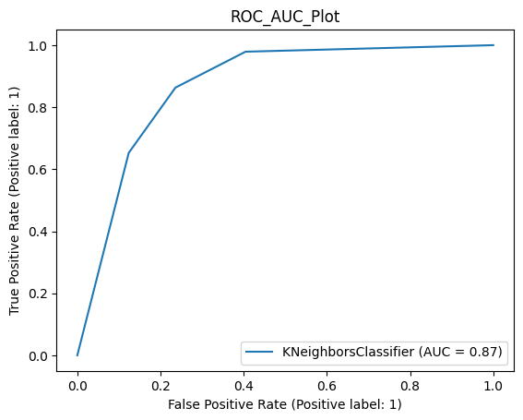
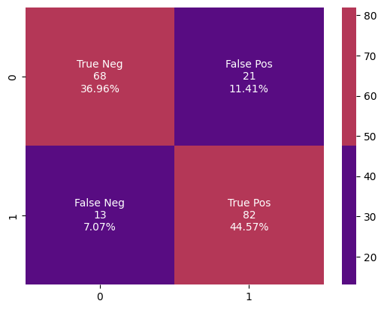
4. Modelling
5. K-Nearest Neighbour Classifier
Accuracy : 81.52%
Cross Validation Score : 89.34%
ROC_AUC Score : 81.36%

Slide 23
5. Conclusion
This dataset is great for understanding how to handle binary classification problems with the combination of numerical and categorical features.
Subject matter experts, in this case doctors or nurses, can be assisted by providing insights that enables them to take the next line of action.
For modeling, hyperparameter tuning is not done. It can push the performances of the algorithms. Overall the algorithm performances are good.
Logistic Regression and SVC shows highest Accuracy of 87.78%
Folder with all work - Drive
This is an early stage of using ML approaches but suggests that it could prove to be an excellent adjunct to patient care.

Slide 24
Thank You
Notes:
Mapping of categorical parameters with numerical parameters for better understanding of the datapoints

